Slide 1
SUPPLY CHAIN DATA CLEANING AND VISUALIZATION
Supply Chain Visibility and Optimization
Ashvitha S
Chandrika Ruthala
Harish Vishal
Aarav Kumar
Ashita

Slide 2
Project Overview & Objectives
Why this project exists, what it covers, and what it aims to achieve with Power BI
PROJECT OVERVIEW
KEY OBJECTIVES
1
Goal
1
Analyze Revenue Performance
Clean and prepare raw supply chain data for accurate, reliable analysis.
Evaluate sales and identify high-performing categories and warehouses.
Why It Matters
2
Monitor Order & Fulfillment
2
Analyze total orders and fulfillment status efficiency.
Messy data leads to unreliable delivery, inventory, and cost insights.
3
Evaluate Delivery & Logistics
3
Scope
Analyze transport modes, delivery status, and average delivery time.
Orders, products, suppliers, warehouses, transport, and payments across 4 states.
4
Identify Inventory Risks
4
Approach
Classify stock into Healthy, Medium, and Low Stock categories.
Python (pandas) in Google Colab, through a structured cleaning workflow.
5
Evaluate Supplier Performance
Compare suppliers by revenue contribution and fulfillment performance.
5
Team Effort
A 5-member team handled inspection, cleaning, validation, and documentation.
6
Analyze Product Returns
Identify categories with higher return rates and improvement areas.
6
Outcome
Enable Data-Driven Decisions
A clean, analysis-ready dataset with a fully documented workflow.
7
Interactive Power BI dashboard with KPIs, filters, and visuals.

Slide 3
Problem Statement
Supply chain organizations rely on accurate data to manage orders, inventory, suppliers, transportation, and deliveries.
However, the raw dataset contains missing values, duplicate records, inconsistent text formats, and incorrect data, which can lead to inaccurate analysis and poor decision-making.
Therefore, the dataset must be cleaned and preprocessed to improve its quality, consistency, and reliability before performing data analysis and visualization.
KEY ISSUES
Missing Values
Duplicate Records
Inconsistent Formats
Incorrect Data

Slide 4
Dataset Description
supply_chain_dataset_rawdata.xlsx
Key Columns
4,129
20
Order & Product
Order_ID, Product_ID, Product_Name, Category, Quantity, Unit_Price, Total_Amount
RECORDS
COLUMNS
Logistics
3
4
Supplier, Warehouse, Transport_Mode, Order_Date, Delivery_Date, Delivery_Status
PRODUCT CATEGORIES
WAREHOUSES / STATES
Customer & Ops
Customer_City, State, Payment_Status, Inventory_Level, Return_Flag, Priority, Employee_ID
Columns by Category
20 columns across 3 functional groups

Slide 5
Supply Chain Data-to-Insight Workflow
From raw data to visibility & optimization insights
1
2
3
4
5
6
7
Raw Dataset
Detect Issues
Handle Missing
Values
Remove
Duplicates
Standardize &
Recalculate
Clean Dataset
Visualize &
Optimize
4,129 orders, 20 columns
Missing values, duplicates, inconsistent text
Median fill (numeric), "Unknown" (categorical)
7 duplicate rows dropped
Text casing fixed, Total_Amount recomputed
4,122 rows, 0 missing, powering the Power BI dashboards
Power BI dashboards drive fulfillment & inventory decisions
Tools: Python (pandas)

Slide 6
Handling Missing Values
2,261 missing values found across 6 of 20 columns
Column
Missing
%
Method Used
Supplier
862
20.9%
fillna("Unknown")
Warehouse
827
20.0%
fillna(mode()[0])
Total_Amount
218
5.3%
fillna(Quantity × Unit_Price)
Delivery_Date
136
3.3%
fillna(Order_Date)
Quantity
118
2.9%
fillna(median())
Unit_Price
100
2.4%
fillna(mean())
Code Used
df.drop_duplicates(inplace=True)
df["Quantity"] = df["Quantity"].fillna(df["Quantity"].median())
df["Unit_Price"] = df["Unit_Price"].fillna(df["Unit_Price"].mean())
df["Supplier"] = df["Supplier"].fillna("Unknown")
df["Warehouse"] = df["Warehouse"].fillna(df["Warehouse"].mode()[0])
df["Delivery_Date"] = df["Delivery_Date"].fillna(df["Order_Date"])
df["Total_Amount"] = df["Total_Amount"].fillna(df["Quantity"] * df["Unit_Price"])

Slide 7
DAX Calculations
Key DAX Measures & Calculations
DAX measures were created to calculate business KPIs and support interactive analysis of sales, orders, fulfillment, delivery, inventory, suppliers, and returns.
1. Sales & Orders
3. Average Delivery Time
Total Sales =
SUM(SupplyChain[Sales])
Total Orders =
DISTINCTCOUNT(SupplyChain[Order_ID])
Delivery Days = DATEDIFF(
SupplyChain[Order_Date],
SupplyChain[Delivery_Date], DAY)
Average Delivery Days =
AVERAGE(SupplyChain[Delivery Days])
2. Fulfillment & Delivery
Fulfillment Rate = DIVIDE(
CALCULATE([Total Orders],
Delivery_Status="Delivered"),
[Total Orders], 0)
Delayed Orders =
CALCULATE([Total Orders],
Delivery_Status="Delayed")
Used In Dashboard
These measures power the Fulfillment Rate, Delayed Orders, and Average Delivery Days KPI cards shown across the Power BI dashboard views.
Tools: Power BI Desktop · DAX

Slide 8
DAX Calculations
Key DAX Measures & Calculations (Continued)
Additional DAX measures were created to power the in-transit, returns, inventory-risk, and supplier-analysis visuals on the Power BI dashboards.
4. Returns
6. Supplier Analysis
Returned Orders =
CALCULATE([Total Orders],
Return_Flag="Yes")
Return Rate = DIVIDE([Returned Orders],[Total Orders],0)
Total Suppliers =
DISTINCTCOUNT(SupplyChain[Supplier])
Supplier Fulfillment Rate =
DIVIDE(CALCULATE([Total Orders],
Delivery_Status="Delivered"),[Total],0)
5. Inventory Risk
Inventory Risk =
SWITCH(TRUE(),
Inventory_Rate <= 100,
"Low Stock",
Inventory_Rate <= 300,
"Medium Stock",
"Healthy Stock")
Used In Dashboard
These measures power the Return Rate, Inventory Risk Distribution, In Transit Orders, and Supplier Fulfillment Performance visuals across the Power BI dashboard.
Tools: Power BI Desktop · DAX

Slide 9
Dashboard Visualization & Analysis
Power BI Dashboard Overview
The dashboard was designed to provide an interactive view of supply chain performance, letting users monitor KPIs and analyze revenue, fulfillment, logistics, inventory, supplier performance, and returns.
1
Dashboard 1 — Supply Chain Performance
2
Dashboard 2 — Inventory, Supplier & Returns
Purpose: Provide an executive-level overview of business performance.
KPIs: Total Sales · Total Orders · Fulfillment Rate · Return Rate · Low Inventory Rate
Key Visualizations: Monthly Revenue Trend · Revenue by Warehouse · Orders by Transport Mode · Revenue by Category · Order Fulfillment
Purpose: Identify operational risks and supplier/inventory performance.
KPIs: Delayed Orders · In Transit Orders · Average Delivery Days · Total Suppliers
Key Visualizations: Revenue by Supplier · Supplier Fulfillment Performance · Inventory Level by Category · Return Rate by Category · Inventory Risk Distribution · Top 10 Products by Revenue

Slide 10
Key Insights from the Dashboard
What the Power BI Dashboards Reveal About Performance and Risk
The Power BI dashboards revealed important patterns in revenue, fulfillment, logistics, inventory, supplier performance, and product returns that highlight where operational improvements are needed.
Key Findings
Revenue Concentration
Warehouse Performance
1
2
Electronics drives ~₹2.2B in revenue, far ahead of Office and Accessories — the business is highly dependent on this one category.
Pune leads warehouse revenue at ~₹1.4B, ahead of Hyderabad, Chennai, and Bangalore — a model worth replicating elsewhere.
Transportation & Fulfillment
Delivery Performance
3
4
Road transport handles the most orders (~1.6K), yet only 41.12% of orders are delivered — the rest sit pending, delayed, or in transit.
Average delivery time is 4.84 days — a benchmark to compare against the company's target delivery SLAs.
Inventory Risk
Supplier Performance
5
6
55.9% of inventory sits in medium or low-stock risk (37.97% / 17.93%); only 44.10% is classified as healthy stock.
Canon leads supplier revenue (~₹660M), but high revenue doesn't mean high fulfillment — Samsung fulfills best (~50%) while Dell lags (~34%).
Return Rate
7
Overall return rate is 49.9%, with category-level rates near the same mark — a high enough figure to warrant investigating product, quality, fulfillment, or customer-experience causes.

Slide 11
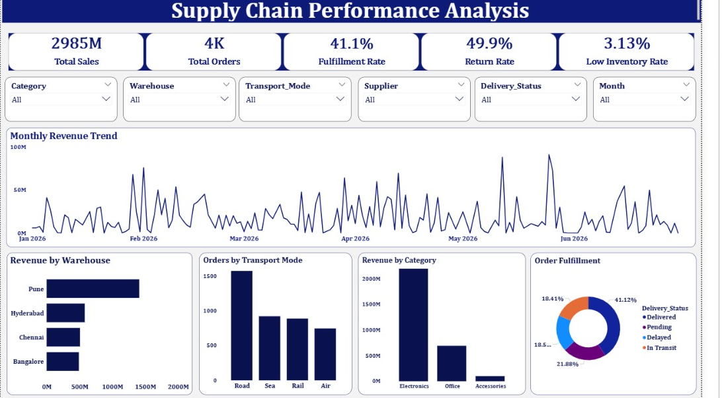
Power BI Dashboard – Supply Chain Performance
Total sales, fulfillment rate, monthly revenue trend, and orders by warehouse/mode/category

Slide 12
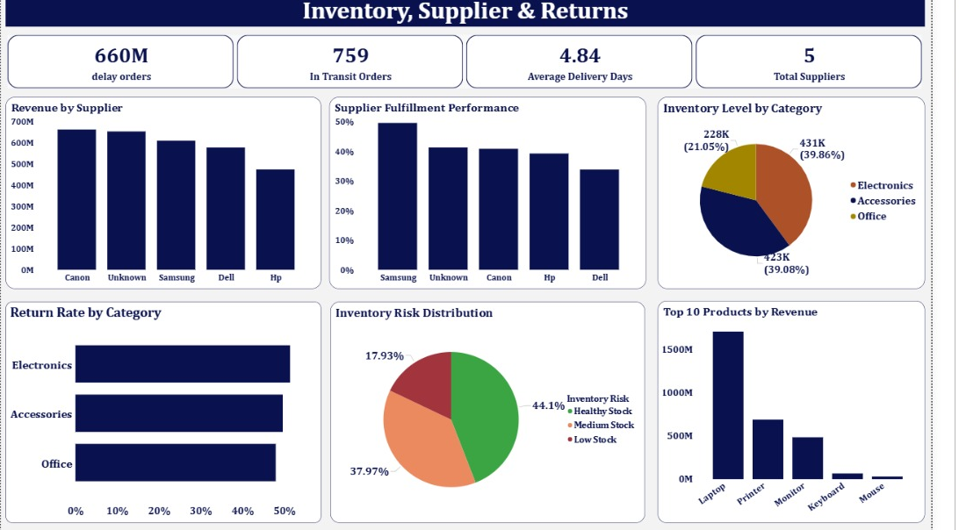
Power BI Dashboard – Inventory, Supplier & Returns
Supplier fulfillment performance, inventory risk distribution, and top products by revenue

Slide 13
Milestone 3: Advanced Power BI Visualizations
Milestone 3 focuses on advanced Power BI visualizations for supply chain analysis.
The dashboards provide interactive insights into transportation costs, warehouse performance, delivery efficiency, transport modes, and key business trends.
Advanced visuals such as Scorecards, Maps, Matrices, Decomposition Trees, Q&A, and Narrative Insights are used to improve data exploration and decision-making.
KEY VISUALS USED
Scorecards & Maps
Transportation Matrix
Decomposition Tree
Q&A + Narrative

Slide 14
Milestone 3: Approach & Methodology
Building on the cleaned dataset and DAX measures from Milestone 2, Milestone 3 follows a structured approach to designing advanced Power BI visuals.
Each business question -- supplier performance, transportation cost, route efficiency, or executive KPIs -- was mapped to the advanced visual type best suited to answer it.
Visuals were built, validated against the underlying DAX measures, and refined for clarity before being organized into four focused dashboards.
METHODOLOGY STEPS
Map Business Questions
Select Visual Type
Build & Validate
Refine for Clarity

Slide 15
Milestone 3: Tools & Techniques Used
Power BI Desktop was used throughout, extending the DAX measures from Milestone 2 with advanced, interactive visual types.
Filled Maps and Matrix visuals surface geographic and cost patterns, while the Decomposition Tree enables drill-down analysis by warehouse, state, and supplier.
The Q&A visual and Narrative Insights add natural-language exploration and automated summaries on top of the existing dashboard model.
TOOLS & TECHNIQUES
Power BI Desktop
Filled Map & Matrix
Decomposition Tree
Q&A + Narrative

Slide 16
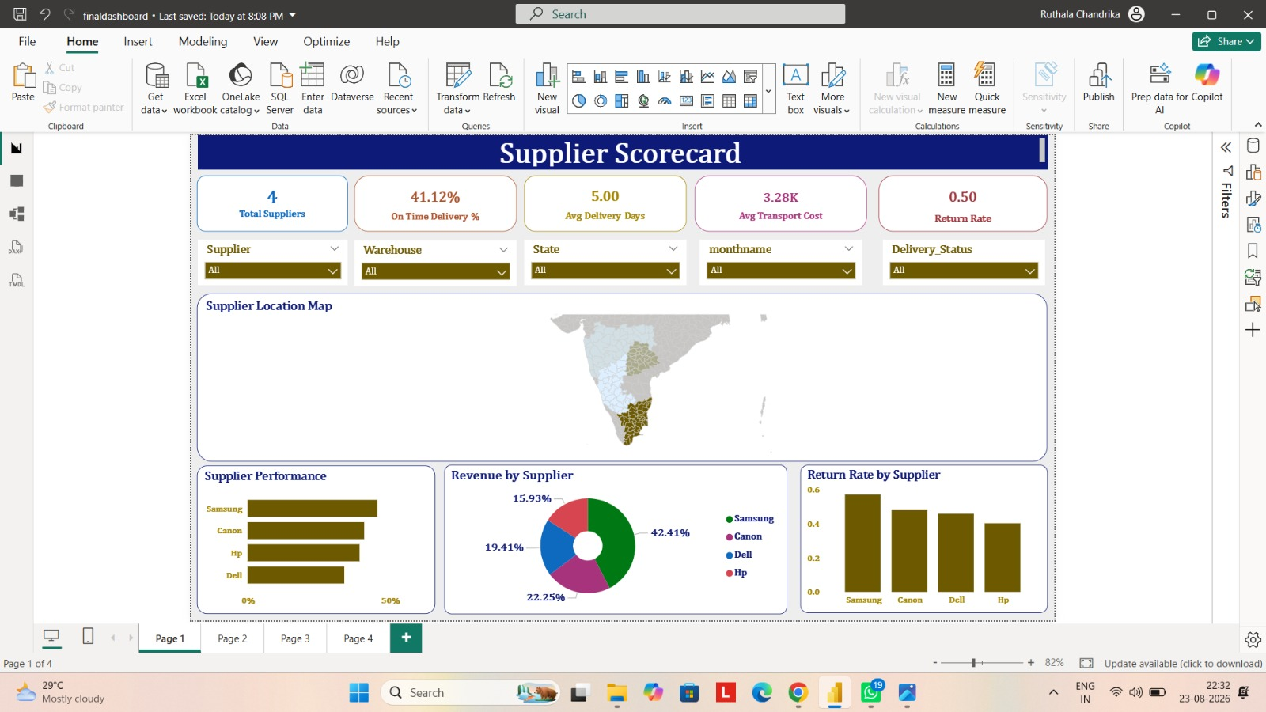
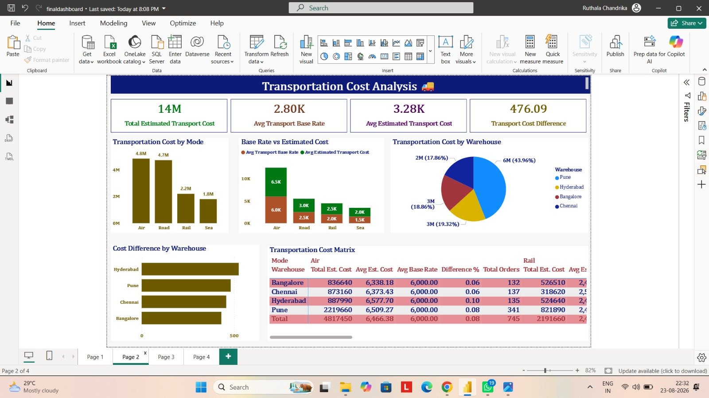
Milestone 3: Advanced Power BI Visualizations
Part 1 of 2 — Scorecard using Map & Transportation Cost using Matrix
Dashboard 1: Supplier Scorecard using Map
Dashboard 2: Transportation Cost Analysis using Matrix
1. Scorecard using Map
2. Transportation Cost using Matrix
High-level overview of supply chain performance using KPI scorecards and geographic map analysis.
Compares estimated transportation costs across warehouses and transport modes (Air, Rail, Road, Sea) using a matrix visual.
KPIs: Total Suppliers · On-Time Delivery % · Avg Delivery Days · Avg Transport Cost · Return Rate
KPIs: Total Estimated Transport Cost · Avg Transport Base Rate · Avg Estimated Transport Cost · Cost Difference %
Visuals: Filled Map by State · Supplier Performance Bar Chart · Revenue by Supplier Donut · Return Rate by Supplier
Visuals: Transportation Cost Matrix · Cost by Transport Mode Bar Chart · Base Rate vs Estimated Cost · Cost by Warehouse

Slide 17
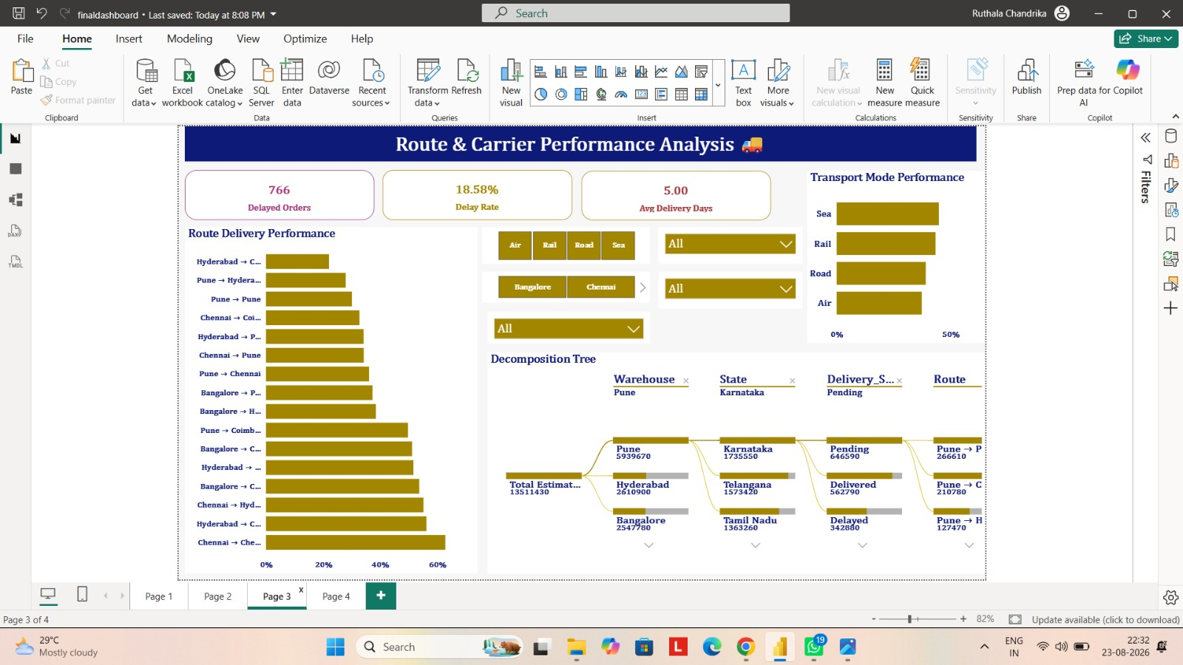
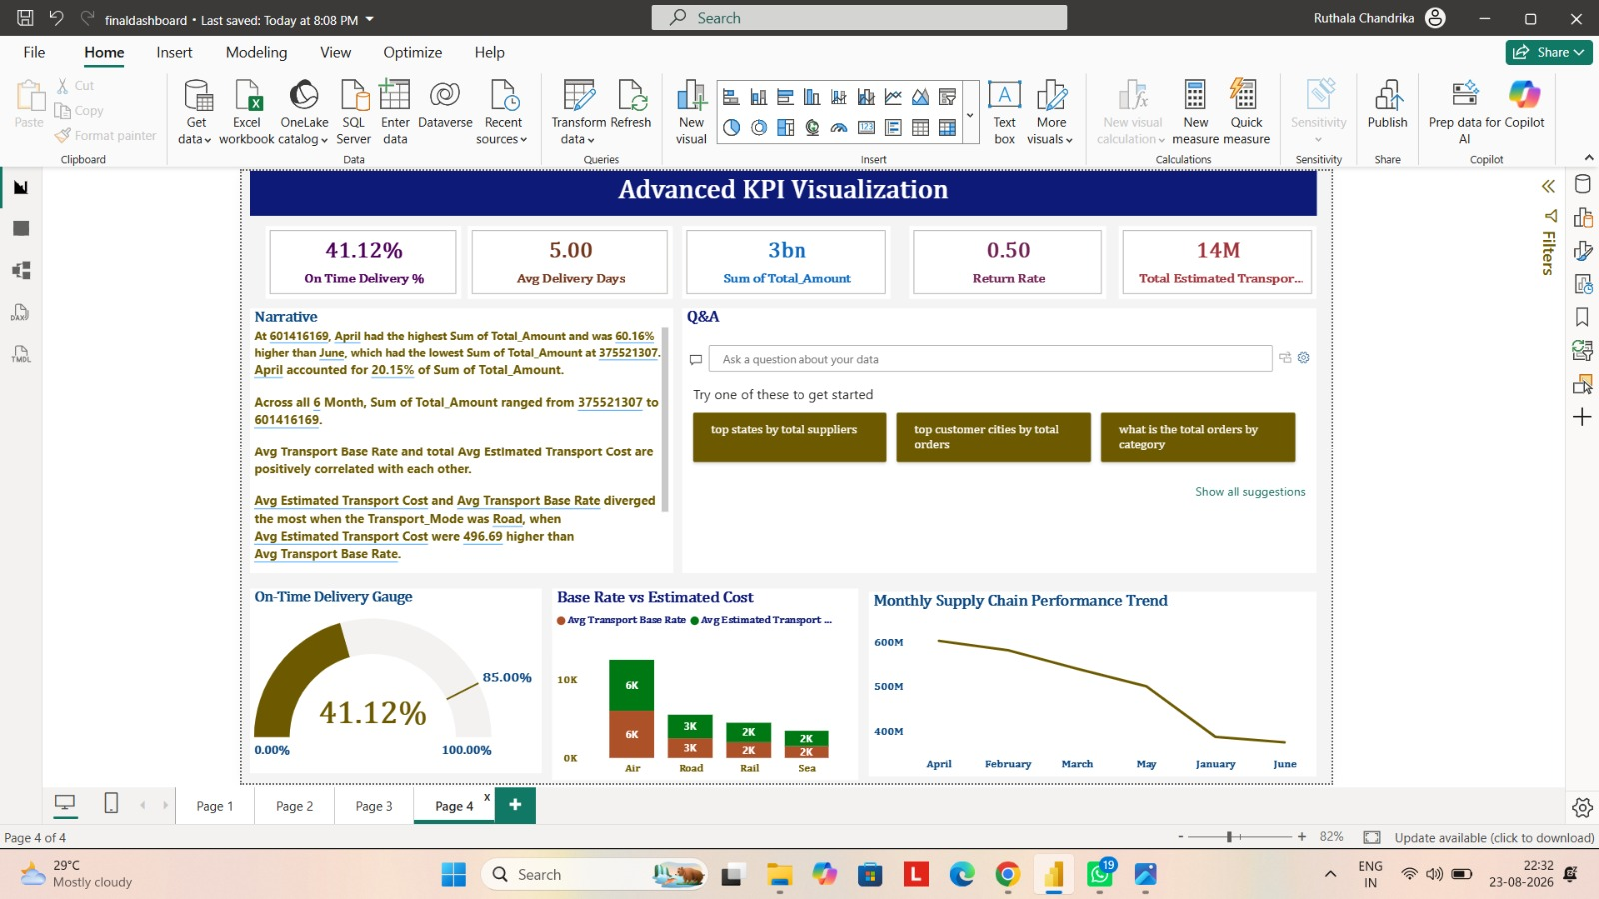
Milestone 3: Advanced Power BI Visualizations
Part 2 of 2 — Decomposition Tree & Q&A / Narrative Insights
Dashboard 3: Route & Carrier Performance using Decomposition Tree
Dashboard 4: Advanced KPI Visualization with Q&A and Narrative
3. Route & Carrier Performance using Decomposition Tree
4. Q&A and Narrative Insights
Breaks down supply chain performance across Warehouse, State, Delivery Status, Transport Mode, and Supplier via an interactive drill-down tree.
Power BI Q&A lets users ask natural-language questions about the dataset, while Narrative auto-summarizes key insights.
KPIs: Total Orders · Delayed Orders · Delay Rate · Avg Delivery Days
KPIs: On-Time Delivery % · Avg Delivery Days · Total Estimated Transport Cost · Return Rate
Visuals: Decomposition Tree · Route Delivery Performance Bar Chart · Transport Mode Performance
Visuals: Q&A Visual · Narrative / Summary · On-Time Delivery Gauge · Monthly Trend Line

Slide 18
Milestone 4: Approach & Methodology
Milestone 4 shifts focus from building visuals to evaluating performance, consolidating results into executive-ready views, and preparing the report for deployment.
Warehouse and supplier metrics from earlier dashboards were aggregated into efficiency and executive overview reports for quick, high-level decision-making.
The report was then optimized for speed and reliability, and every KPI, DAX measure, and visual was tested before final documentation and deployment.
METHODOLOGY STEPS
Aggregate & Summarize
Build Executive View
Optimize Performance
Test & Deploy

Slide 19
Milestone 4: Tools & Techniques Used
Power BI Desktop remained the core tool, with the Performance Analyzer used to profile report load time and query response.
DAX measures were streamlined and the data model simplified to reduce visual clutter and speed up filter and slicer interactions.
Final validation covered KPI and DAX accuracy, filter and slicer behavior, and visual interactions, supported by written data-cleaning and dashboard documentation.
TOOLS & TECHNIQUES
Power BI Desktop
Performance Analyzer
DAX Optimization
Documentation & Testing

Slide 20
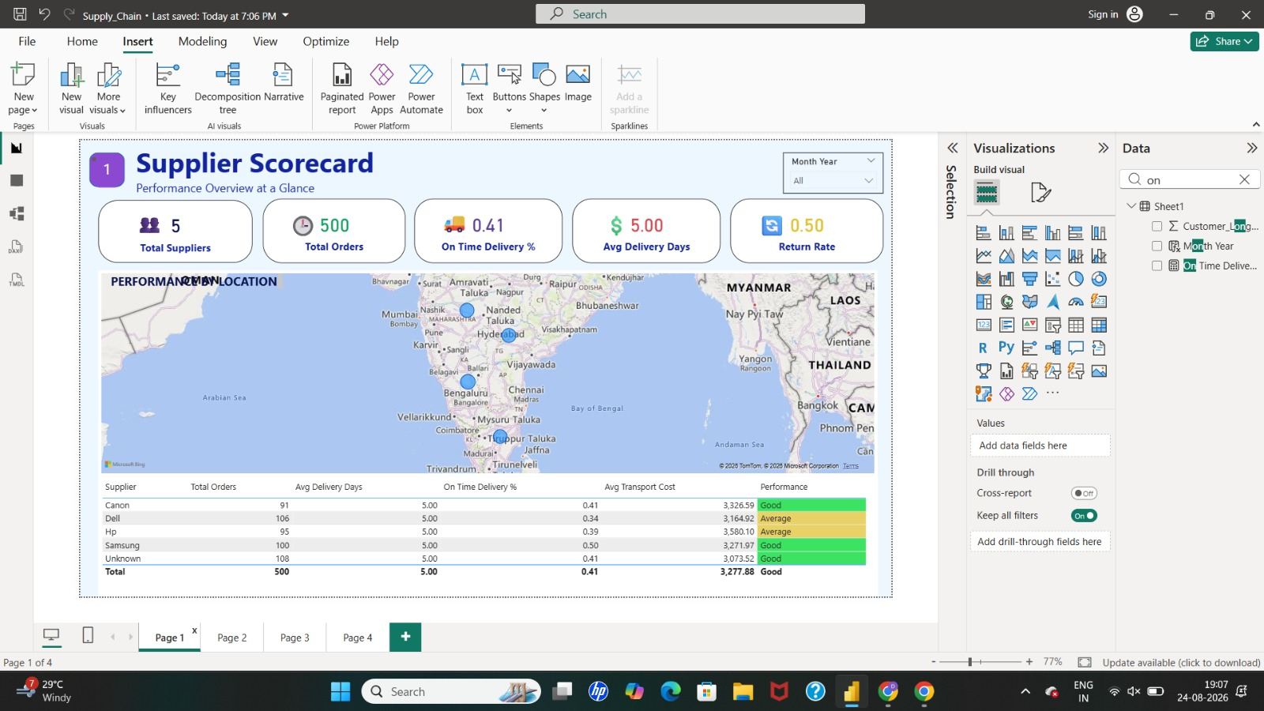
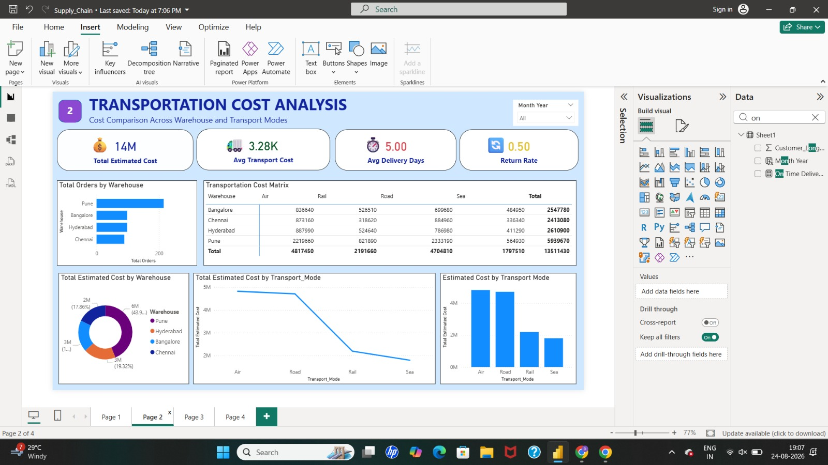
Milestone 4: Warehouse & Executive Overview
Part 1 of 2 — Warehouse Efficiency Report & Executive Overview Dashboard
Supplier Scorecard — reviewed for warehouse & supplier efficiency
Transportation Cost Analysis — feeds the executive cost summary
1. Warehouse Efficiency Report
2. Executive Overview Dashboard
Compares warehouses on revenue, order volume, fulfillment, delivery performance, inventory levels, and transportation performance to flag high- and under-performing sites.
Gives management a simple, high-level view of the most important supply chain KPIs for quick decision-making.
KPIs: Total Orders by Warehouse · On-Time Delivery % · Avg Delivery Days · Return Rate
KPIs: Total Sales · Total Orders · Fulfillment Rate · Return Rate · Avg Delivery Days
Visuals: Revenue & Orders by Warehouse · Cost by Warehouse · Delivery Performance by Warehouse
Visuals: Inventory Risk · Warehouse Performance · Supplier Performance Summary

Slide 21
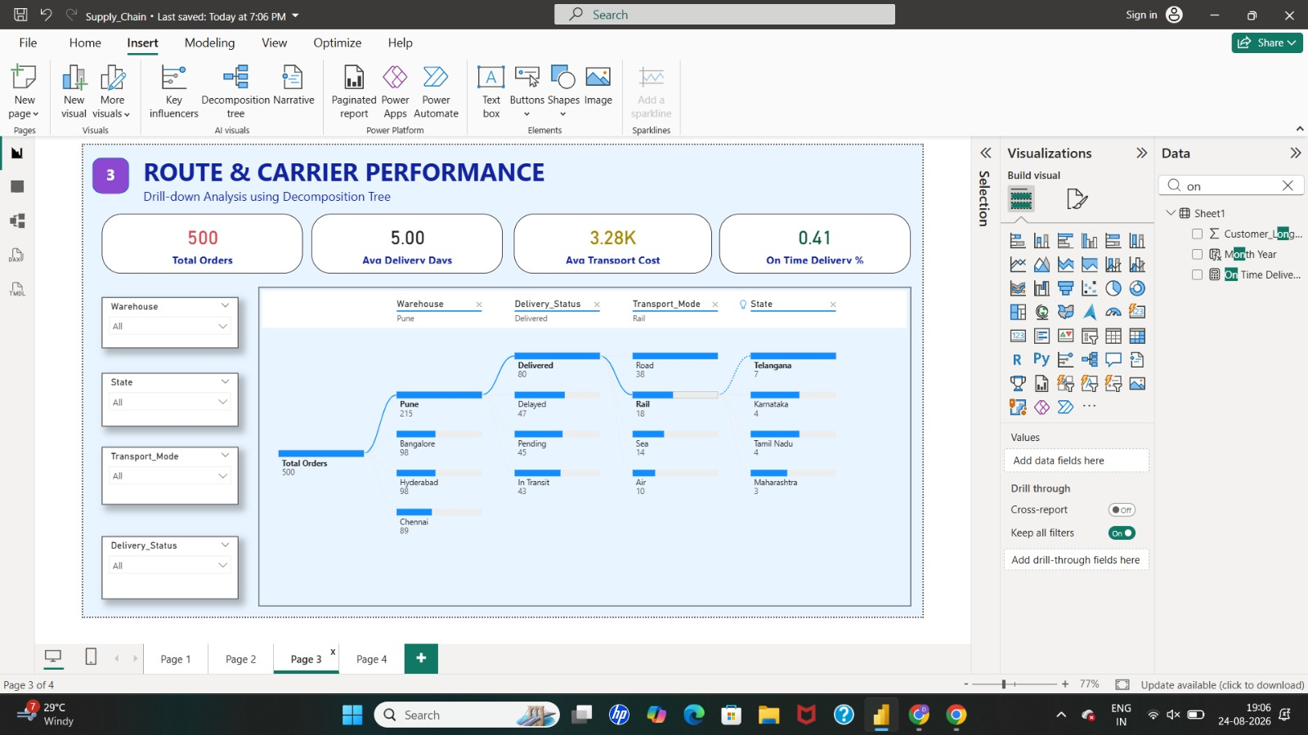
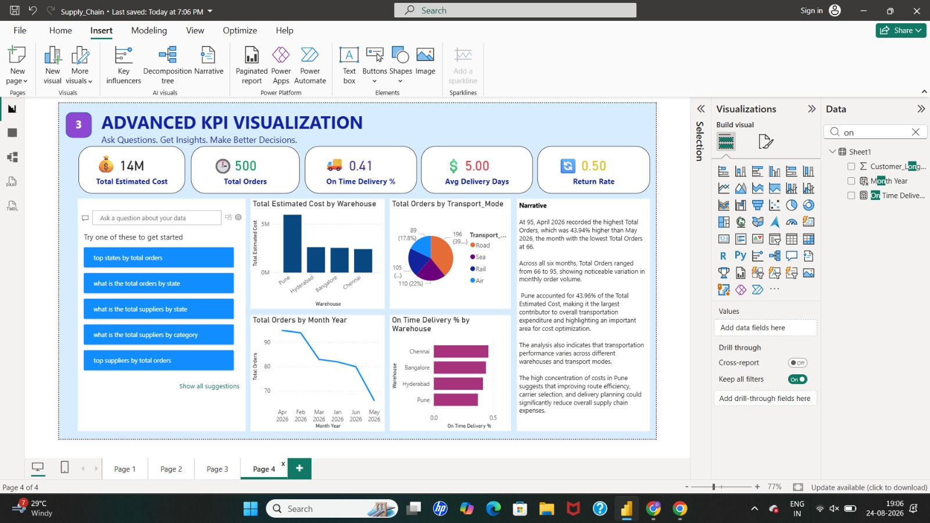
Milestone 4: Optimization, Testing & Deployment
Part 2 of 2 — Dashboard Optimization & Final Testing / Deployment
Route & Carrier Performance — validated during dashboard testing
Advanced KPI Visualization — optimized for faster report performance
3. Optimize Dashboard Performance
4. Final Testing, Documentation & Deployment
Tuned for faster report loading, efficient DAX measures, a leaner data model, and smoother filter/slicer interactions.
KPIs, DAX measures, filters, slicers, and all visuals (Map, Matrix, Decomposition Tree, Q&A, Narrative) were tested for accuracy, then the report was prepared for stakeholder deployment.
KPIs: Report Load Time · Visual Count per Page · Query Response Time
KPIs: KPI & DAX Accuracy · Filter / Slicer Behavior · Visual Interactions
Visuals: Faster Loading · Efficient DAX · Reduced Visual Clutter · Optimized Data Model
Visuals: Data-Cleaning & DAX Documentation · Dashboard Purpose & Key Insights Doc

Slide 22
Conclusion
Dashboard analysis reveals a 41.1% fulfillment rate against a 49.9% return rate — a clear visibility gap between what is ordered and what is successfully fulfilled.
Electronics (~₹2.2B) and the Pune warehouse (~₹1.4B) drive the bulk of revenue, while inventory risk is concentrated in medium/low stock (37.97% / 17.93%) and supplier fulfillment ranges from ~34% (Dell) to ~50% (Samsung).
These insights rest on a solid foundation: the raw 4,129-row dataset was cleaned to 4,122 consistent, analysis-ready rows by resolving 2,261 missing values and removing 7 duplicate records.
Together, the cleaned dataset and Power BI dashboards give full visibility into delivery, inventory, and supplier performance — the foundation for supply chain optimization.
TEAM
Ashvitha S
Chandrika Ruthala
Harish Vishal
Aarav Kumar
Ashita

